Slide 1
Multi-threaded Series
Multithreading basic concept, thread pool
1. Thread , Runnable , Future etc
2. ThreadPool
Lock related concepts and examples
1. volatile
2. synchronized
3. lock in JUC
Multi-threaded problem solving experience
1. Producer and Consumer Problem in Java
2. Troubleshooting, Log Tools, JVM args, System limits
3. Extension & summarize, AKKA Framework

Slide 2

Producer and Consumer Problem in Java
https://github.com/exiaoqu/ProducerConsumerProblemInJava
Java Instructor Committee(JIC)
Concurrent Programming in Java
Xiaoyu Qu
exiaoqu
BID CBC Compass
2018-06-22

Slide 3
AGENDA
Producer-consumer problem
Java Cross-thread Solutions
Java Cross-process(JVM) Solutions

Slide 4
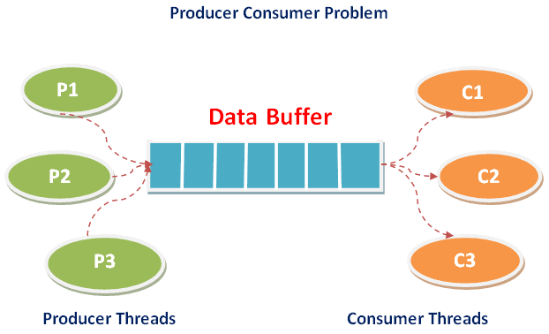
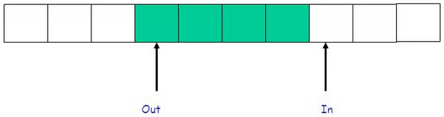
Producer-consumer problem
One classic, concurrent multi-thread synchronization problem
Producers write data to buffer
Consumers read data from buffer
Shared buffer holds the produced data which is not yet consumed
Also called the bounded-buffer problem
bounded-buffer : size N
Buffer is circular
Notes:
* What is a bounded-buffer?

Slide 5
Java Cross-thread Solutions
Wait and Notify
Lock and Condition
BlockingQueue
PipedInputStream and PipedOutStream

Slide 6
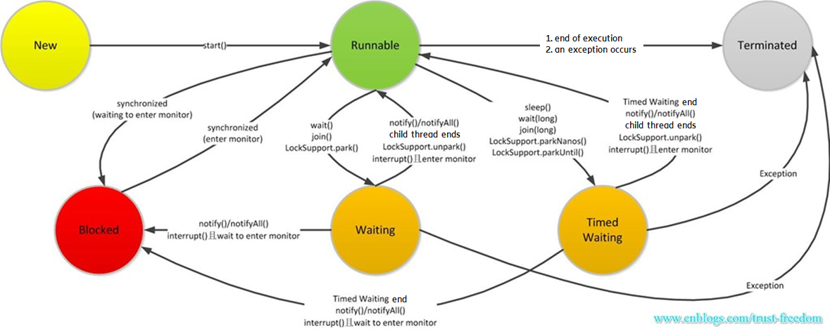
Java Thread State Figure
\\bjg.cn.ao.ericsson.se\X$\DUIB_China\XI\XIT\XIT_All\XIT_Java_Instructor_Committee\20180803_Concurrent_Programming_By_Xiaohan_and_Ningning

Slide 7
Wait and Notify
Facilities
Synchronized and Synchronized(Object)
Non-fair # Fair
Reentrant # Non-reentrant
Exclusive # Share Lock
Mutex # ReadWriteLock
Pessimistic # Optimistic
wait()/wait(timeout)/wait(timeout, nanos)
notify()/notifyAll()
Notes:
基础设施:
Synchronized关键字和Synchronized(Object)语句
Non-fair(非公平) schedule only # Fair(公平) schedule
Reentrant (锁定区可重入) # Non-reentrant不可重入
Exclusive (排它锁) # Share Lock(共享锁)
Mutex (互斥锁） # ReadWriteLock(读写锁)
Pessimistic(悲观锁) # Optimistic(乐观锁)
Object的wait()/ wait(timeout)方法
Object的notify()/notifyAll()方法
公平锁： Threads acquire a fair lock in the order in which they requested it 非公平锁： A non-fair lock permits barging: threads requesting a lock can jump ahead of the queue of waiting threads if the lock happens to be available when it is requested.
锁定区可重入: 线程可以进入任何一个它已经拥有的锁所同步着的代码块。
共享锁：该锁可被多个线程共有，典型的就是ReentrantReadWriteLock里的读锁。读锁是共享锁，写锁是排它锁。
悲观锁：总是假设最坏的情况，每次去拿数据的时候都认为别人会修改，所以每次在拿数据的时候都会上锁，这样别人想拿这个数据就会阻塞直到它拿到锁。
乐观锁：顾名思义，就是很乐观，每次去拿数据的时候都认为别人不会修改，所以不会上锁，但是在更新的时候会判断一下在此期间别人有没有去更新这个数据，可以使用版本号等机制。

Slide 8
Wait and Notify
Demo

Slide 9
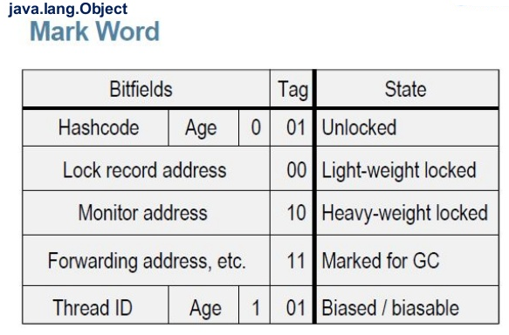
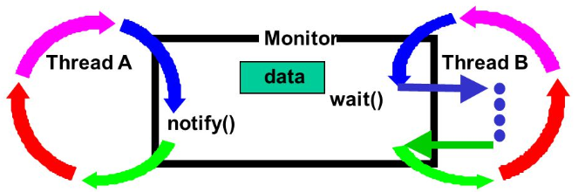
Wait and Notify
Question A:
When does the monitor lock upgrade happen?
Can you describe the procedure of it?
https://wiki.openjdk.java.net/display/HotSpot/Synchronization
Notes:
原理
生产者和消费者线程对Object对象的monitor线程互斥锁的锁定竞争
Synchronized 锁定
wait 释放锁定->等待被Notify(或超时)->竞争并重新获得锁定
notify 唤醒处于锁等待状态的线程(Non-fair)
退出作用域释放锁
Demo
Synchronized内部的锁升级过程:
Biased Lock -> Lightweight Lock -> Heavyweight lock(偏向锁/轻量级锁/重量级锁)

Slide 10
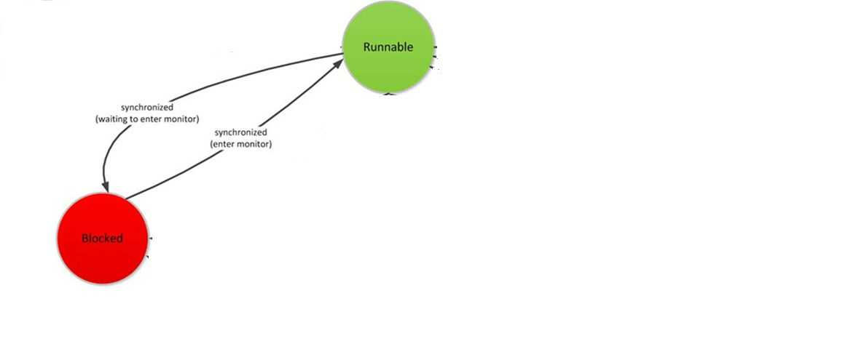
Enter Synchronized Block(First Time, Object lock count 0 -> 1)
(Compete the lock)
1) - Enter monitor block(hold the lock) directly
2) - Enter Blocked on the lock, non-interruptible
3) – Awaken by OS, until acquire the monitor lock
1)
2)
3)
Question: how can we properly terminated a thread if it is blocked on a monitor lock which will never be released ?

Slide 11

Wait()
Enter Waiting
1) –Release the lock, exit from monitor block
2) - Enter Waiting, append to the lock waiting queue
Exit from Waiting, removed from lock waiting queue
3) –Being notified
4) - Being interrupted
*spurious waken up
5) - Enter monitor block again, wait() returns
6) - Enter Blocked on the lock, non- interruptible.
1)
5)
2)
3)
4)
Question: If a thread is staying in wait(), another thread hold the monitor lock and never release, Could the waiting thread be properly terminated?
6)

Slide 12
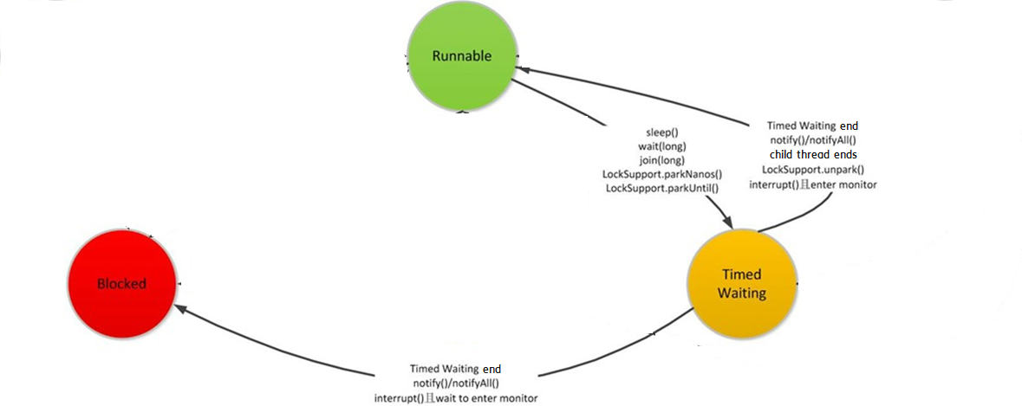
wait(timeout)/wait(timeout, nanos)
Enter Waiting
1) – Release the lock, exit from monitor block
2) - Enter Timed Waiting
Exist from Timed Waiting
3) –being notified
4) - being interrupted
7) - timeout
*spurious waken up
5) - enter monitor block again, wait() returns
6) - enter Blocked on the lock, non- interruptible.
1)
5)
Question: If a thread is staying in wait(timeout), another thread hold the monitor lock and never release, Could the thread be properly terminated?
7)
2)
3)
4)
6)

Slide 13
Notify()
– Wake up a “random-selected” Waiting/Timed-Waiting thread
NotifyAll()
– Wake up all Waiting/ Timed-Waiting threads
Exit from the Synchronized Block(Last Time, Object lock count 1->0)
- Release monitor lock

Slide 14
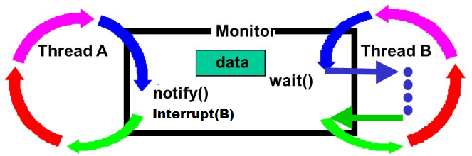
Question B1:
Thread B is staying in wait(), but another thread A notify() then Interrupt() it, after thread A release the lock, Would the Thread B be interrupted first or notified first?

Slide 15
Lock and Condition
Facilities(Introduced in Java1.5)
ReentrantLock(non-fair)
Default non-fair or Fair # Fair: it is only “favor granting access to the longest-waiting thread”.
Reentrant # Non-reentrant
Exclusive # Share Lock
Mutex # ReadWriteLock
Pessimistic # Optimistic
Lock()/tryLock()/tryLock(timeout)/lockInterruptibly()
Conditions
Create from the lock object and only work with it
Precisely wake-up control with different conditions
await()/awaitUninterruptibly()/await(timeout), awaitNanos(timeout), awaitUntil(date)
signal()/signalAll()
Notes:
基础设施
Lock
ReentrantLock
Non-fair(非公平) 或 Fair(公平) schedule
Reentrant (锁定区可重入) # Non-reentrant不可重入
Exclusive (排它锁) # Share Lock(共享锁)
Mutex (互斥锁） # ReadWriteLock(读写锁)
Pessimistic(悲观锁) # Optimistic(乐观锁)
Lock()/tryLock()/tryLock(timeout)
Condition 从Lock对象中创建出任意数目，只能和该锁配合使用
await()/await(timeout)
signal()/signalAll()
ReentrantLock.lockInterruptibly允许在等待时由其它线程调用等待线程的Thread.interrupt方法来中断等待线程的等待而直接返回，这时不用获取锁，而会抛出一个InterruptedException。 ReentrantLock.lock方法不允许Thread.interrupt中断,即使检测到Thread.isInterrupted,一样会继续尝试获取锁，失败则继续休眠。只是在最后获取锁成功后再把当前线程置为interrupted状态,然后再中断线程。

Slide 16
Lock and Condition
Demo
Notes:
原理
生产者和消费者线程对Lock对象进行锁定竞争
Lock.lock() 锁定(或超时)
可使用Multiple Condition Objects实现精确唤醒控制
Condition.await() 释放锁定->等待被Signal(或超时)->竞争并重新获得锁定
Condition. signal() 唤醒处于锁等待状态的线程(Non-fair/Fair)
Demo

Slide 17
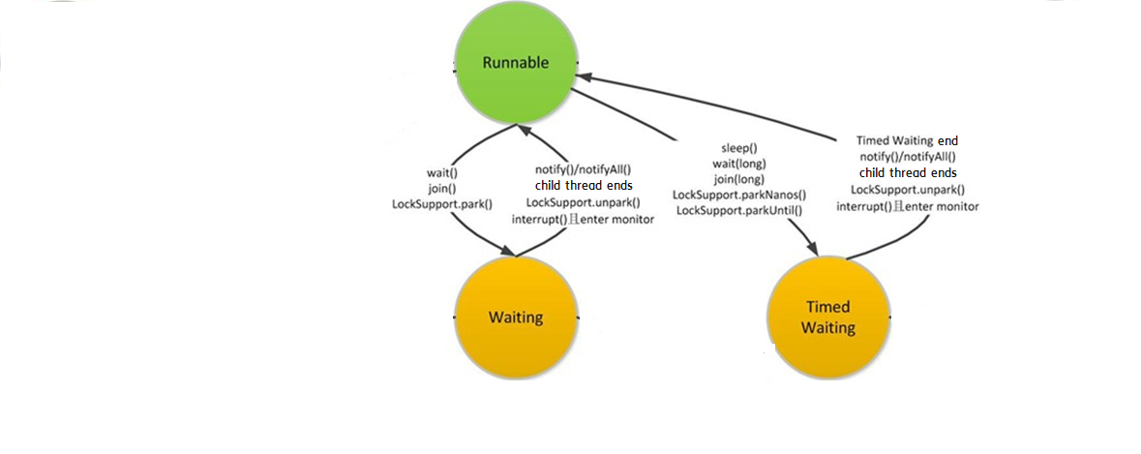
lock() - (First Time, Object lock count 0 -> 1)
1) - hold the lock, lock() returns
2) –Waiting on the lock, non-interruptible
Question: how can we properly terminated a thread if it lock() on a lock which will never be released ?
lockInterruptibly()
1) – hold the lock, lock() returns
2) –Waiting on the lock, interruptible
1)
tryLock()
1) - Always in Runnable
either hold the lock, return true
or return false
2)
2)
trylock(timeout)
1) – hold the lock, trylock(timeout) return true
2) - Timed Waiting on the lock, timeout return false, interruptible

Slide 18
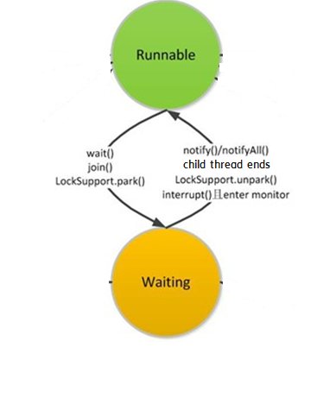
await()
Enter Waiting
1) – Release lock
2) - Waiting on the condition, interruptible
Question: If a thread is staying in await(), another thread hold the lock and never release, Could the waiting thread be killed?
1)
Wake up
3) –Being signaled
4) - being interrupted
*spurious waken up
2)
5)
Compete the lock
5) – Exit from Waiting, hold the lock, await() returns
6) –Waiting on the lock, non-interruptible, wake up and compete the lock.
3)
4)
6)

Slide 19
awaitUninterruptibly()
Enter Waiting
1) – Release lock
2) - Waiting on the condition, non-interruptible
1)
Wake up
3) –Being signaled
*spurious waken up
2)
5)
Compete the lock
5) – Exit from Waiting, hold the lock, awaitUninterruptibly() returns
6) –Waiting on the lock, non-interruptible, wake up and compete the lock.
3)
6)

Slide 20
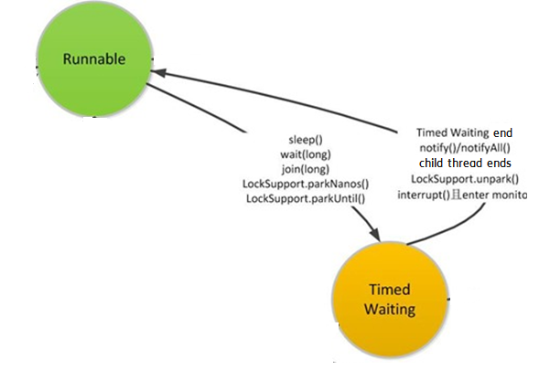
await(timeout), awaitNanos(), awaitUntil(date)
Enter Waiting
1) – Release lock
2) - Timed Waiting on the condition, interruptible
1)
Wake up
3) –Being signaled
4) - Being interrupted
7) - Timeout
*spurious waken up
5)
2)
Compete the lock
5) – Exit from Timed Waiting, hold the lock, await() returns
6) –Timed Waiting on the lock, non-interruptible, wake up and compete the lock.
3)
4)
6)
7)

Slide 21
*Random-selected detail?
Signal()
1) –move the first(*) wait on condition thread to wait on the lock, stay in Waiting state
2) –move the first(*) wait on condition thread to wait on the lock, stay in Timed Waiting state
SignalAll()
3) – all threads waiting on condition move to waiting on the lock, all stay in Waiting state
4) – all threads waiting on condition move to waiting on the lock, all stay in Timed Waiting state
Unlock() - (Last Time, Object lock count 1->0)
1) – release the lock

Slide 22
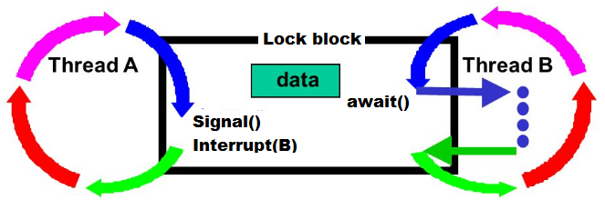
Question B2:
Thread B is staying in await(), but another thread A signal() then Interrupt() it, after thread A release the lock, Is the Thread B interrupted first or notified first?

Slide 23
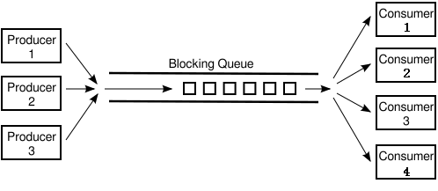
BlockingQueue
Facilites
BlockingQueue
LinkedBlockingDeque<>(capacity) used
Default capacity = Integer.MAX_VALUE
put() blocking write
take() blocking read
Solution Description
The blocking queue internally handles blocking and wakeup, which simplifies the design. Internal of it is a buffer that balances the processing power of producers and consumers.
Notes:
基础设施
BlockingQueue
LinkedBlockingDeque<>(capacity)
Default capacity = Integer.MAX_VALUE
put() 阻塞写入对象
take() 阻塞取出对象
原理
阻塞队列会处理阻塞和唤醒，这样简化了设计。其内部相当于一个缓冲区，可以平衡生产者和消费者的处理能力。

Slide 24
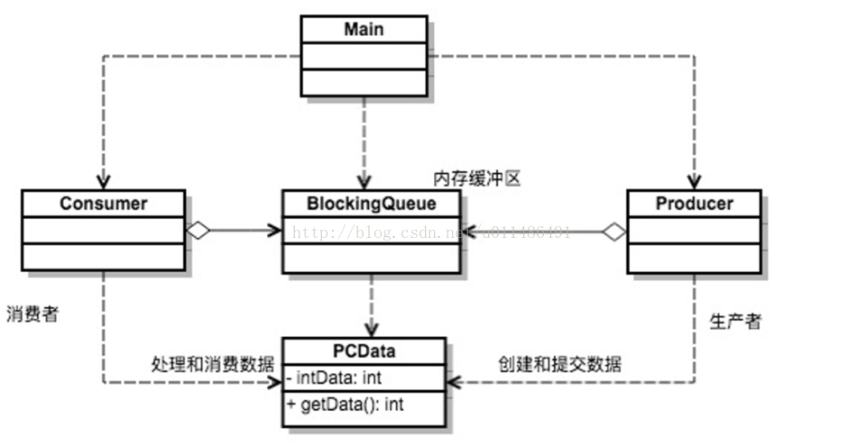
BlockingQueue
Java producer-consumer pattern

Slide 25
BlockingQueue
Demo
Separated lock and condition for producer and consumer
Half lock-free queue
lockInterruptibly() and await() internally used
Alternative non-blocking solution
Lock-free queue: ConcurrentLinkedQueue

Slide 26
PipedInputStream/PipedOutputStream
Facilities
PipedInputStream: receive byte stream
PipedOutputStream: send byte stream
Solution Description
Associate output stream with input stream
Use the internal buffer of PipedInputStream(Default 1024 bytes)
Use internal locks in PipedInputStream/PipedOutputStream
Based on byte stream, exists delimitation problem

Slide 27
PipedInputStream/PipedOutputStream
Demo
Synhcronized and wait()/notify() internally used.

Slide 28
Java Cross-thread Summary
Tight Coupling
Thread can not be properly terminated
BlockingQueue is simplest, and do not neglect the lock-free ConcurrentLinkedQueue.
Monitor has a special bias lock, adaptive spining mechanism

Slide 29
Java Cross-process(JVM) Solutions
NIO and MappedByteBuffer(Java SHM solution)
Using Linux SystemV-IPC MQ through JNA

Slide 30
NIO and MappedByteBuffer
Facilites
NIO FileChannel
MappedByteBuffer
Using OS memory-mapped file mechanism(max 2G Bytes, Integer.MAX_VALUE)
Using direct byte buffer
Solution Description
Share memory-mapped file among processes
Mapped as direct byte buffer
Using the exclusive lock in FileChannel(File system lock)
Notes:
基础设施
NIO FileChannel(类似Unix-like OS上的文件描述符)
MappedByteBuffer
使用底层操作系统的Memory-mapped file机制
和Direct Byte Buffer
原理
跨JVM共享内存影射文件
使用直接内存Buffer做缓存区
使用FileChannel的排它锁

Slide 31
NIO and MappedByteBuffer
Demo

Slide 32
Using SystemV-IPC MQ through JNA
Facilites
System V IPC MQ(Linux System Call)
int msgget(key_t key, int msgflg)
int msgsnd(int msqid, const void *msgp, size_t msgsz, int msgflg)
size_t msgrcv(int msqid, void *msgp, size_t msgsz, long msgtyp, int msgflg)
JNA Library
Origin from Sun, open source on top of JNI, using in Java side。
Solution Description
Using SystemV-IPC Message Queue in Unix/Linux OS
Data contained in each message buffer
Using internal mechanism in kernel, invisible to application
Notes:
基础设施
System V IPC / Linux System Call
int msgget(key_t key, int msgflg)
int msgsnd(int msqid, const void *msgp, size_t msgsz, int msgflg)
size_t msgrcv(int msqid, void *msgp, size_t msgsz, long msgtyp, int msgflg)
JNA库
源于Sun公司， 开源基于JNI的库，用于Java侧。
原理
使用操作系统的SystemV-IPC 消息队列
每个消息中的内存区
使用内核里的锁，对应用不可见
JNA(Java Native Access)是一个开源的Java框架，是Sun公司推出的一种调用本地方法的技术，是建立在经典的JNI基础之上的一个框架。之所以说它是JNI的替 代者，是因为JNA大大简化了调用本地方法的过程，使用很方便，基本上不需要脱离Java环境就可以完成。

Slide 33
Q&A

Slide 34
Question C
Does the ReentrantLock has lock upgrade?
A. Has
B. Has not
Webpoll
http://webpoll.rnd.ericsson.se/poll.asp?ID=142841
Notes:
Java8: https://github.com/keerath/openjdk-8-source/blob/master/hotspot/src/os/linux/vm/os_linux.cpp
Java11: https://github.com/jiankunking/openjdk11/blob/master/src/hotspot/os/posix/os_posix.cpp
Spinning pthread mutex : https://stackoverflow.com/questions/23908711/linux-pthread-mutex-and-kernel-scheduler

